Slide 1



Endless
By Vitor Cazella
Student id: 91050051

Slide 2
Overview
Endless is a top to bottom game where you control a spaceship in space
During the game players have to destroy asteroids firing blaster shoots at them
The goal is to destroy all the asteroids and not get hit by any of them

Slide 3
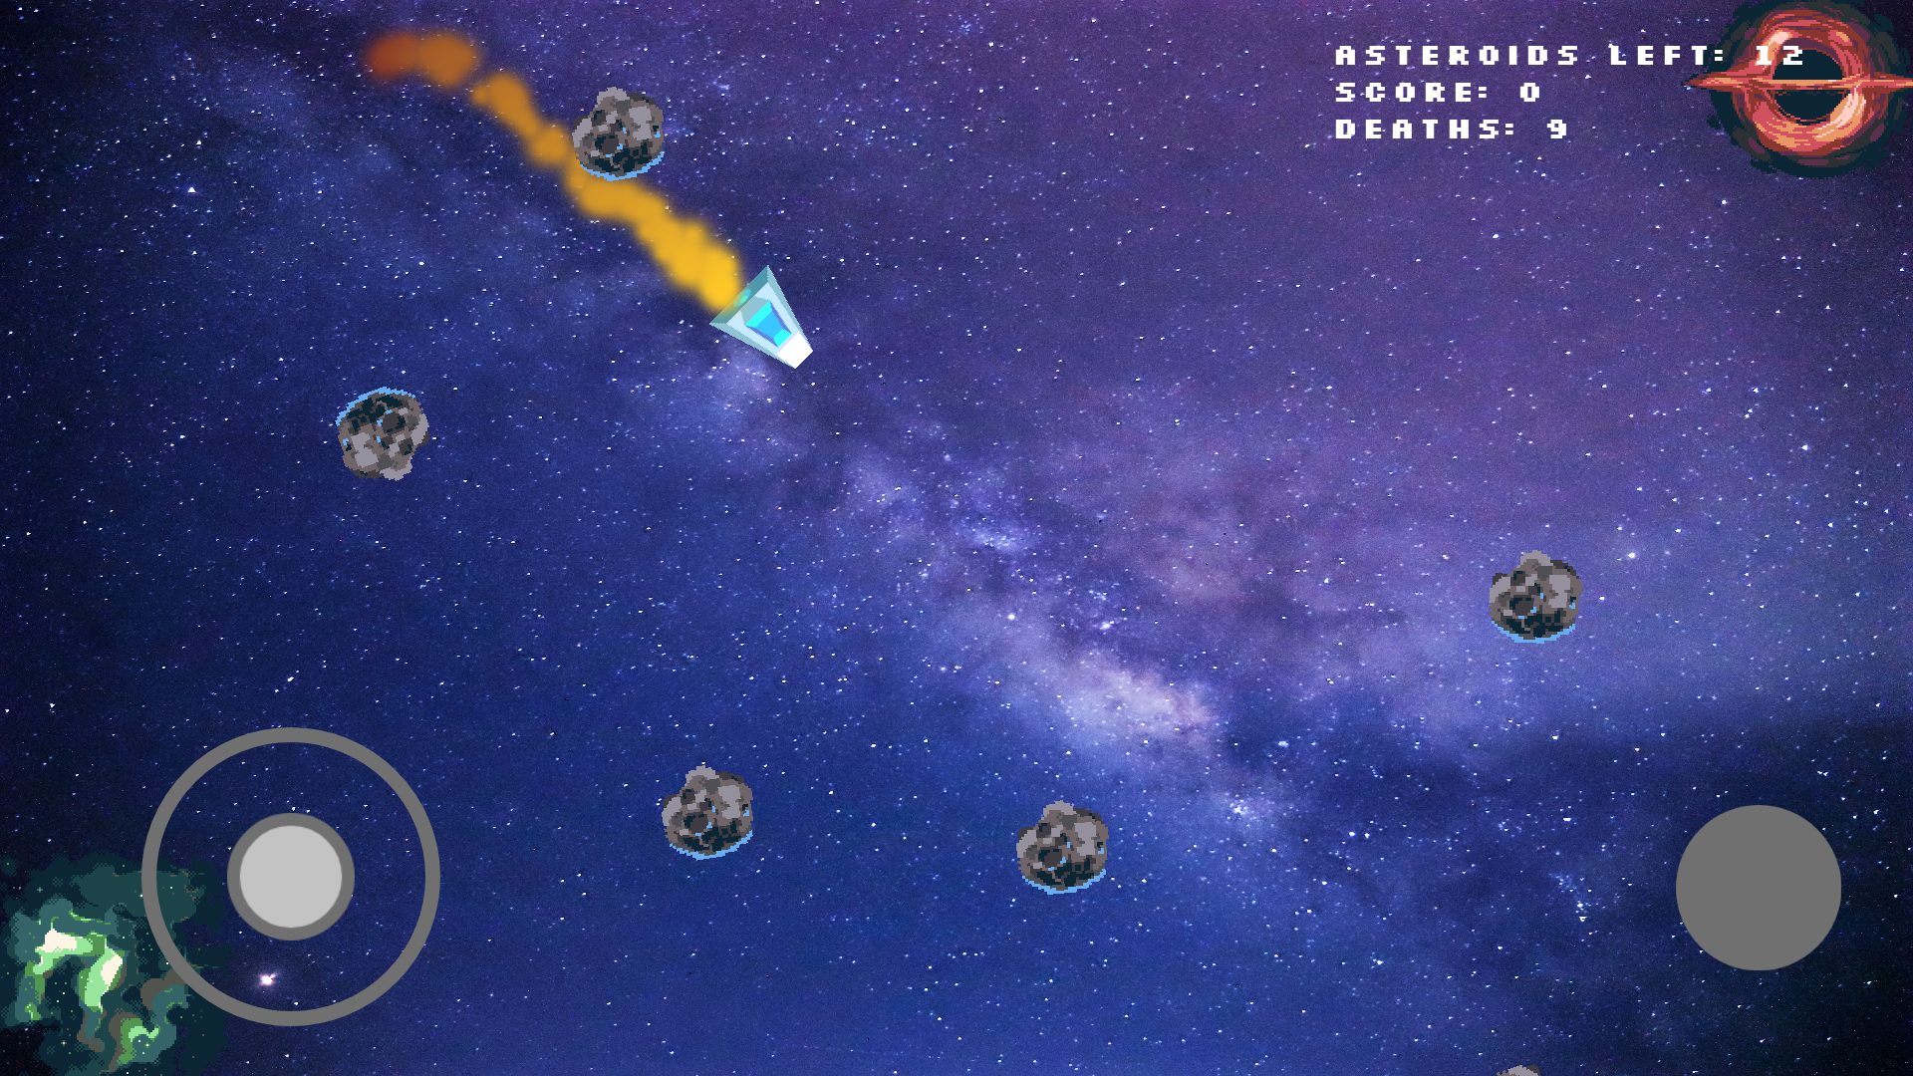
Game design
Joystick and button on HUD for touch screens
Information HUD to give some progression feedback
Static camera
Spaceship particles to give a movement feeling to the character

Slide 4
Challenges
Movement and Physics scripts
Animations
Creating global variables

Slide 5
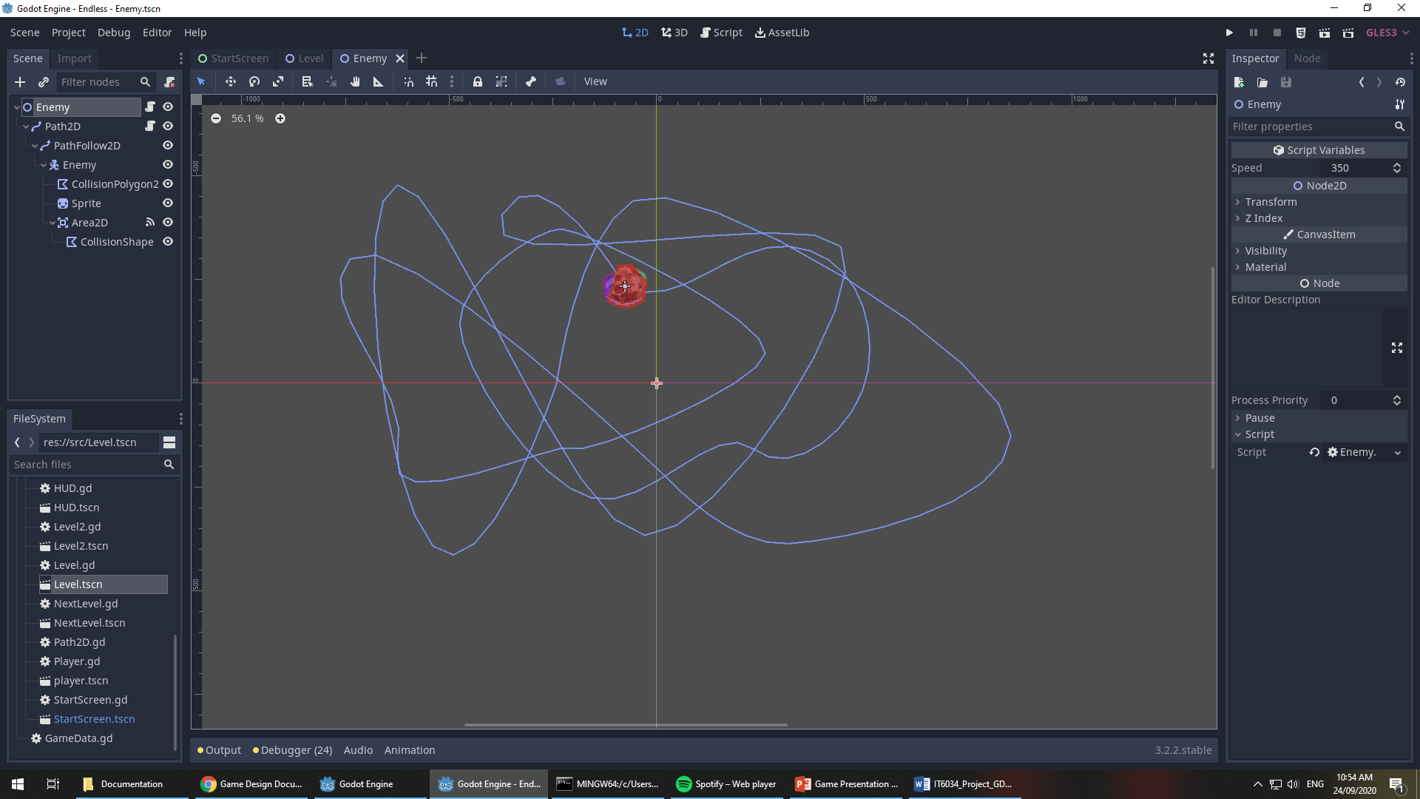
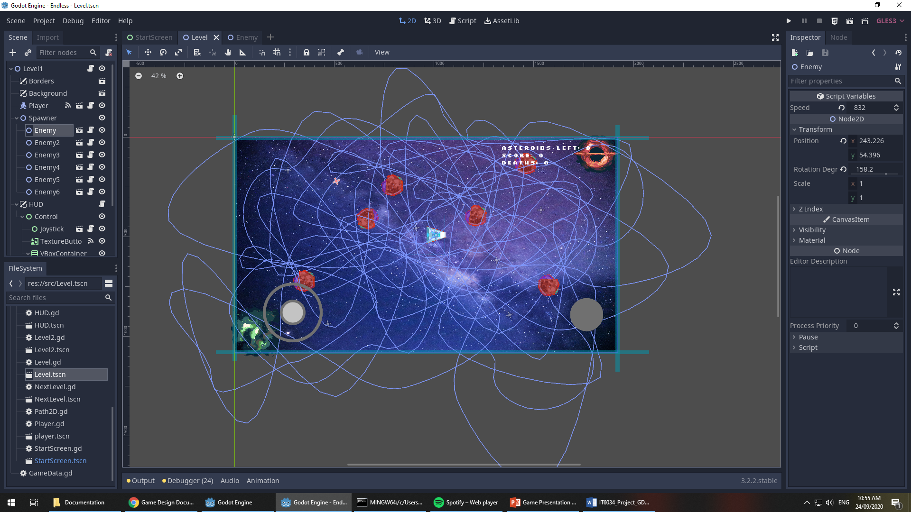
What would I change?

Slide 6
Thank you!
I am opened to questions

